Slide 1


BCNF

Slide 2


List of Content
What is BCNF ?
Example

Slide 3

What is BCNF ?
For a table to be in BCNF:
It should be in 3NF
if every functional dependency X → Y, X is the super key of the table or in simple words,
If Y depends on X then X should be a part of the primary key.

Slide 4
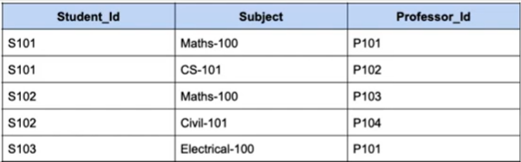

BCNF

Slide 5
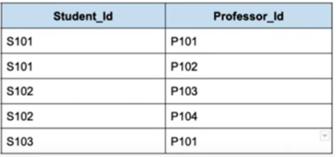
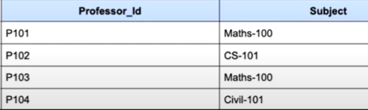

What to do to bring it in BCNF ?

Slide 6
THANK YOU

